Slide 1
Search Algorithms: Object-Oriented Implementation (Part B)
Improved implementation!

Slide 2
Contents
Conventional vs. AI Algorithms
Local Search Algorithms
Implementing Hill-Climbing Algorithms
Defining ‘Problem’ Class
Adding Gradient Descent
Defining ‘HillClimbing’ Class
Adding More Algorithms and Classes
Adding Genetic Algorithm
Experiments

Slide 3
Implementation Reference Notes
review
Search Tool Version
  The Search Tool is implemented in various versions (iteratively expanded & improved).
    v0 (강의. Search Algo. B) : A version where all the code to implement one algorithm is contained in a single file
    v1 (강의. Search Algo. B) : A version implemented by modularizing the logic common to different pieces of code into a separate file, then importing and using that module/file (code refactoring & reuse)
    v2 (강의. Search Algo. C) : A version implemented using classes (v2.1, v2.2)
    v3~v5 : Versions implemented using classes, with some algorithms added, leading to iterative improvements in the code structure
      v3 : 강의. Search Algo. D
      v4 : 강의. Search Algo. E
      v5 : 강의. Search Algo. F
Previous
Today’s

Slide 4
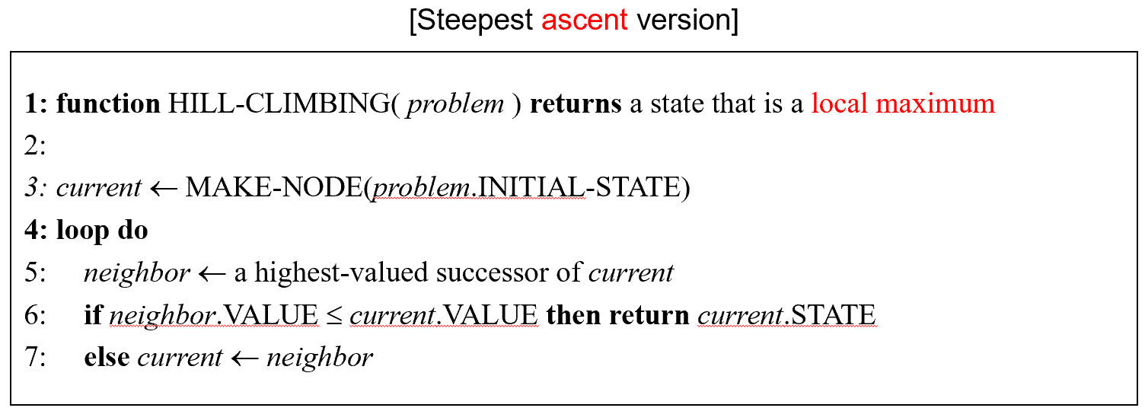
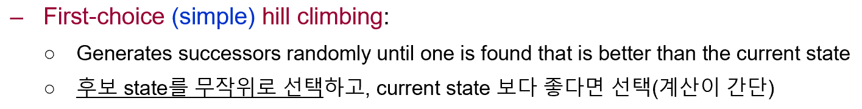
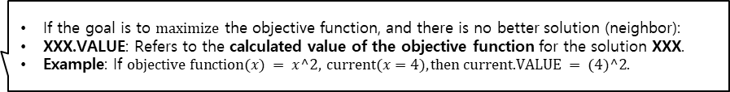
Implementing Hill-Climbing Algorithms
review
Our eventual goal is to implement an optimization tool that can run various search algorithms
We begin to implement two hill climbing algorithms each for two different types of problems: (we implement a total of four hill climbing algorithms)
  Steepest-ascent hill climbing for numerical optimization (SAHC-N)
  First-choice hill climbing for numerical optimization (FCHC-N)
  Steepest-ascent hill climbing for TSP (SAHC-T)
  First-choice hill climbing for TSP (FCHC-T)
Ref:
numerical optimization : The task of finding the variables that maximize or minimize the objective function/value given a mathematical expression/objective function. // continuous
TSP : The problem of calculating the shortest distance to visit all given cities and return to the starting city. // discrete
복습: Hill Climbing Algo. (왼쪽) vs first-choice hill climbing (오른쪽)
If the goal is to $\text{maximize}$ the objective function, and there is no better solution (neighbor):
XXX.VALUE: Refers to the calculated value of the objective function for the solution XXX.
Example: If $\text{objective} \text{function}(x) = x^2, \text{current}(x=4), \text{then} \text{current}\text{.}\text{VALUE} = (4)^2.$

Slide 5
Search Tool v1
Implementation with modularized common logic

Slide 6
Modularity
Numeric Optimization Problem
  Separate the common module from the first-choice(n).py and steepest ascent(n).py files to create a numeric.py file and configure the original two files to import from it.
TSP Problem
  Separate the common module from the first-choice(n).py and steepest ascent(n).py files to create a tsp.py file and configure the original two files to import from it.

Slide 7
Introducing ‘numeric’ Module (for Numerical Optimization)
By moving duplicated codes of SAHC-N and FCHC-N to a separate module named ‘numeric’, we can easily reuse them in both programs by simply importing the module (공통으로 사용하는 로직을 분리하여 따로 저장)
Only a few functions remain in the main programs of SAHC-N and FCHC-N after the code migration (기존 코드가 간결해짐)
displaySetting in SAHC-N and that in FCHC-N are of the same purposes, but with slightly different print messages
SAHC-N
FCHC-N
공통 (import)
main
steepestAscent
mutants
bestOf
displaySetting
main
firstChoice
randomMutant
displaySetting
createProblem
randomInit
evaluate
mutate
describeProblem
displayResult
coordinate
steepest ascent (n).py
first-choice (n).py
numeric.py
Therefore... not separated into a common module

Slide 8
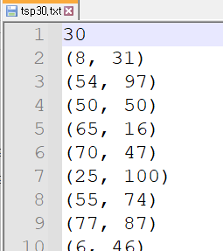
TSP Problem
review
The problem of planning the route (= order of visits) to visit all cities with the shortest total distance.
Assume the problem is input via a text file, as shown below.
  The number of cities is on the first line.
  The subsequent lines contain the coordinates of each city.
# of cities
City coordinates

Slide 9
Steepest-Ascent Hill Climbing for TSP
TSP 문제!
Since the algorithm is the same as that for numerical optimization, the main program of SAHC-N may be reused for TSP without much change
  main, steepestAscent, and bestOf can be reused without any change at all
  mutants should be implemented differently because the representation of candidate solution for TSP is different from that for numerical optimization
  displaySetting should also be changed because there is no notion of mutation step size in solving TSPs
We notice that we need a module like ‘numeric’ to be imported, but the codes in it should be changed appropriately for TSPs

Slide 10
Steepest-Ascent Hill Climbing for TSP
A new module named ‘tsp’ is created for being used as a replacement of the ‘numeric’ module
  The functions createProblem, randomInit, evaluate, describeProblem, and displayResult in ‘numeric’ are also needed in ‘tsp’ but with different implementations
  And there may be some new functions needed for solving TSPs
createProblem():
  Gets a file name from the user and reads problem information from the file
    Number of cities – saved as an integer
    City locations – saved as a list of 2-tuples
  Creates a matrix of distances between every pair of cities (calcDistanceTable – a new function)
  Returns the triple: number of cities, locations, distance table

Slide 11
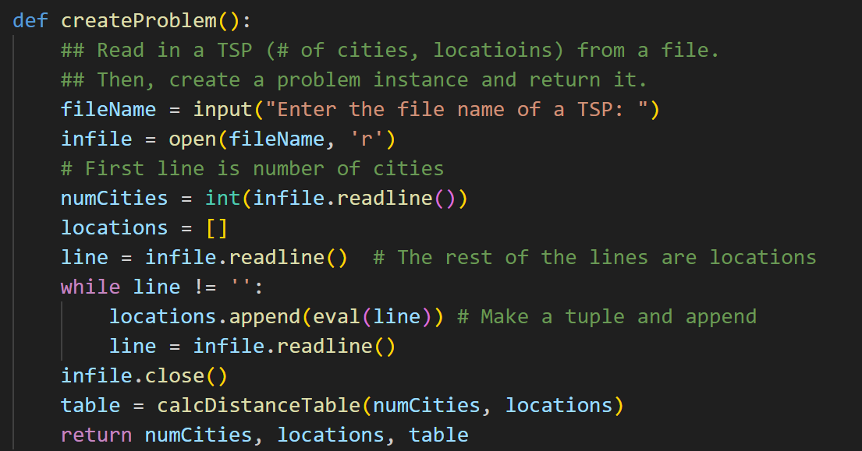
Steepest-Ascent Hill Climbing for TSP
createProblem():
Read number of cities on first line as Integer

Slide 12
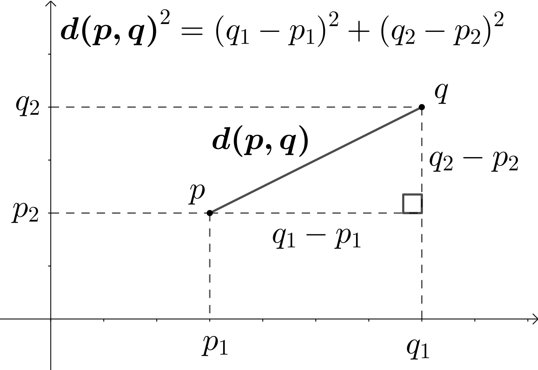

Steepest-Ascent Hill Climbing for TSP
calcDistanceTable(numCities, locations):
  Calculates an n × n matrix of pairwise distances based on locations
  (n = numCities) // use Euclidean distance calculation

Slide 13
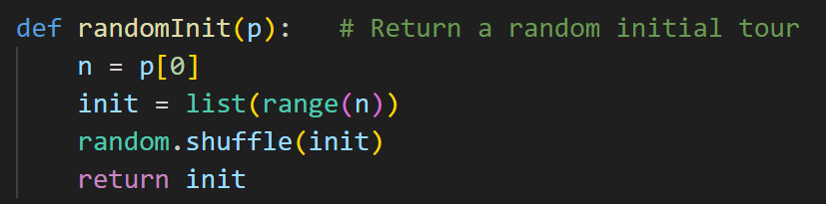
Steepest-Ascent Hill Climbing for TSP
randomInit(p):
  Returns a randomly shuffled list of IDs of the cities in p (= random initial solution)
Evaluate(current, p):
  Calculates the tour cost (= 이동 거리 총합) of current by looking at the distance matrix given in p
  Distance matrix for evaluation is the table output of calcDistanceTable function.
The shuffle function ensure the random list is a valid solution.

Slide 14
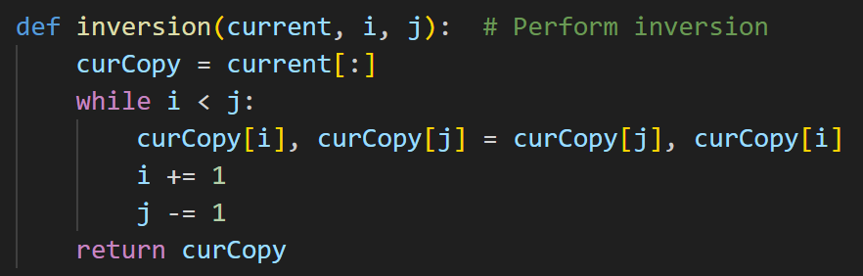

Steepest-Ascent Hill Climbing for TSP
inversion(current, i, j):
  Makes a copy of current, inverts its subsection from $i$ to $j$, and returns the mutant // 인덱스 $i$부터 $j$까지의 모든 item을 뒤집기
  This function takes the role of mutate for numerical optimization // numerical optimization에서 mutate 함수의 역할을 수행
In Python, the exchange of two variables can be easily implemented.
From prev. lecture

Slide 15

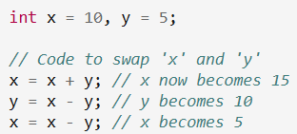
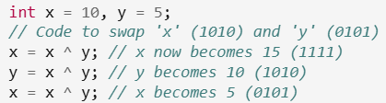
Ref) Variable swapping
The general method for swapping two variables
(using a temporary variable)
Method for swapping without a temporary variable:
1. (Arithmetic)
2. XOR

Slide 16
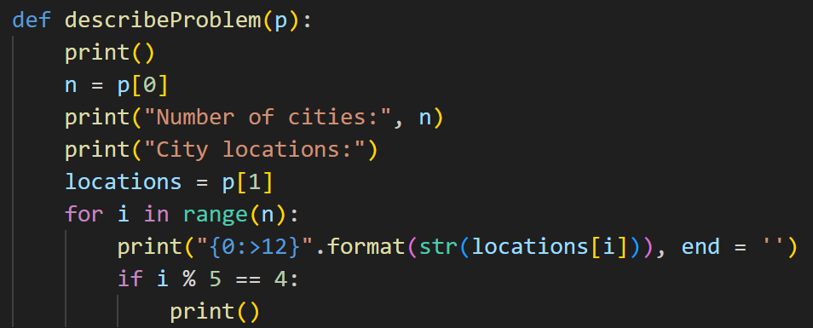
Steepest-Ascent Hill Climbing for TSP
describeProblem(p):
  Prints the number of cities in p, followed by the city locations, five locations per line

Slide 17
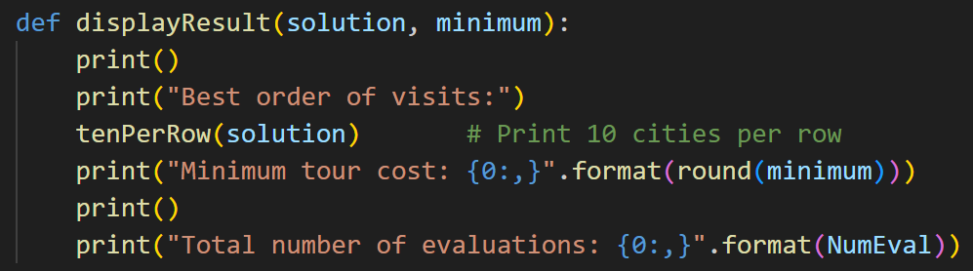
Steepest-Ascent Hill Climbing for TSP
displayResult(solution, minimum):
  Displays solution (the best tour found) (tenPerRow), minimum (its evaluation value), and the total number of evaluations
tenPerRow(solution):
  Prints city ids in order of visit, ten ids per row
  최종 결과(= 도시 방문 순서)를 10개씩 화면에 출력하는 함수

Slide 18
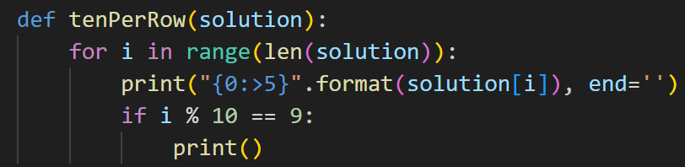
Steepest-Ascent Hill Climbing for TSP
tenPerRow(solution):
  Prints city ids in order of visit, ten ids per row
  최종 결과(= 도시 방문 순서)를 한 줄에 10개씩 화면 출력

Slide 19

Steepest-Ascent Hill Climbing for TSP
Below, we describe how mutants in the main program is implemented differently for TSPs than numerical optimization
  현재의 솔루션을 기준으로, 이웃하는 솔루션을 생성하는 방법 설명
mutants(current, p):
  Returns n neighbors of current (n = number of cities in p),
  Each neighbor is generated by inverting the subsection beginning from i and ending at j (inversion), where the (i, j)-pair is chosen randomly
  The inversion for (i, j)-pair is applied only when i ≠ j and the pair has never been tried before
Reference: In the numerical optimization problem, the mutant function generates$2n$ neighbors.

Slide 20
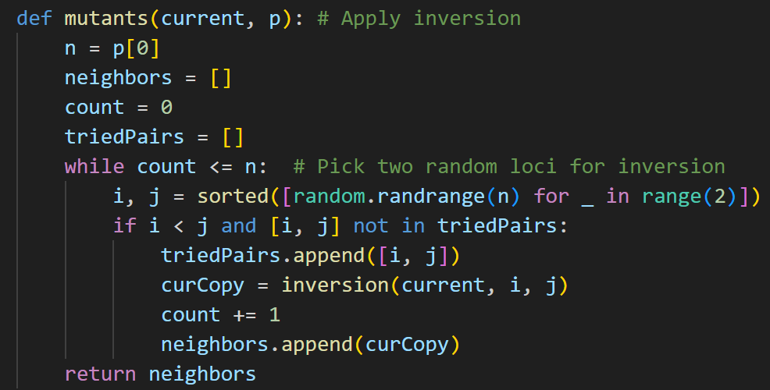
Steepest-Ascent Hill Climbing for TSP
mutants(current, p):

Slide 21
First-Choice Hill Climbing for TSP
FC 알고리즘
The main program of FCHC-N can be reused without much change
  main and firstChoice can be reused without change
  displaySetting needs to be changed because the mutation step size is now irrelevant
  randomMutant should be implemented differently because of the different representation of candidate solution for TSPs
randomMutant(current, p):
  Returns a mutant of current, which is made by inverting the subsection beginning from i and ending at j (inversion), where i and j are chosen randomly

Slide 22
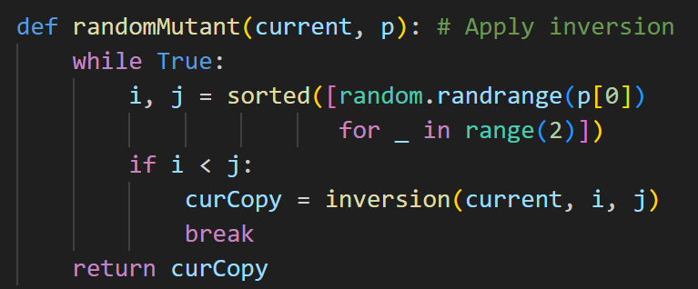
First-Choice Hill Climbing for TSP
randomMutant(current, p):
  Returns a mutant of current, which is made by inverting the subsection beginning from i and ending at j (inversion), where i and j are chosen randomly

Slide 23
Search Tool v1 for TSP
Code configuration after modularization
SAHC-T
FCHC-T
공통 (import)
main
steepestAscent
mutants
bestOf
displaySetting
main
firstChoice
randomMutant
displaySetting
createProblem
calcDistanceTable
randomInit
evaluate
inversion
describeProblem
displayResult
tenPerRow
steepest ascent (tsp).py
first-choice (tsp).py
tsp.py

Slide 24
TSP Problem
Execution Results (Example using the First-Choice Algorithm)
Input the name and path of the .txt file defining the problem (User Input).
Enter the file name of a TSP: problem/tsp30.txt Number of cities: 30 City locations: (8, 31) (54, 97) (50, 50) (65, 16) (70, 47) (25, 100) (55, 74) (77, 87) (6, 46) (70, 78) (13, 38) (100, 32) (26, 35) (55, 16) (26, 77) (17, 67) (40, 36) (38, 27) (33, 2) (48, 9) (62, 20) (17, 92) (30, 2) (80, 75) (32, 36) (43, 79) (57, 49) (18, 24) (96, 76) (81, 39) Search algorithm: First-Choice Hill Climbing Max evaluations with no improvement: 100 iterations Best order of visits: 4 26 2 24 16 27 0 8 10 12 17 18 22 19 3 13 20 29 11 28 23 7 9 6 25 1 14 15 21 5 Minimum tour cost: 491 Total number of evaluations: 677
City 4 (starts from index 0)
The last city is City 29
The Optimal Order of Visits
The Total Distance traveled when following the optimal route.

Slide 25
TSP Problem
Execution Results (Example using the Steepest-Ascent Algorithm)
Input the name and path of the .txt file defining the problem (User Input).
Enter the file name of a TSP: problem/tsp30.txt Number of cities: 30 City locations: (8, 31) (54, 97) (50, 50) (65, 16) (70, 47) (25, 100) (55, 74) (77, 87) (6, 46) (70, 78) (13, 38) (100, 32) (26, 35) (55, 16) (26, 77) (17, 67) (40, 36) (38, 27) (33, 2) (48, 9) (62, 20) (17, 92) (30, 2) (80, 75) (32, 36) (43, 79) (57, 49) (18, 24) (96, 76) (81, 39) Search algorithm: Steepest-Ascent Hill Climbing Best order of visits: 11 29 20 13 3 4 28 23 9 1 7 6 2 16 26 25 21 5 8 15 14 10 0 12 27 24 17 19 18 22 Minimum tour cost: 620 Total number of evaluations: 807
The Optimal Order of Visits
The Total Distance traveled when following the optimal route.

Slide 26


Ref) Adjacency Matrix / 인접 행렬
Adjacency Matrix
  One of the effective ways to represent an Undirected Graph.
  Directly adjacent vertices $\left(i,j\right)$ are represented by 1, and two vertices that are not adjacent are represented by 0.
  The entry for $\left(i,i\right)$ (a vertex's adjacency to itself) is represented by 0.
2
$$\begin{matrix}\begin{matrix}0 & 1 \\ 1 & 0\end{matrix} & \begin{matrix}1 & 0 \\ 0 & 1\end{matrix} \\ \begin{matrix}1 & 0 \\ 0 & 1\end{matrix} & \begin{matrix}0 & 1 \\ 1 & 0\end{matrix}\end{matrix}$$
1
4
3

Slide 27
Ref) Adjacency Matrix / 인접 행렬
Formal Definition
  In graph theory and computer science, an adjacency matrix is a square matrix used to represent a finite graph. The elements of the matrix indicate whether pairs of vertices are adjacent or not in the graph.
  In the special case of a finite simple graph, the adjacency matrix is a (0,1)-matrix with zeros on its diagonal. If the graph is undirected (i.e. all of its edges are bidirectional), the adjacency matrix is symmetric.
    simple graph : a graph that does not have more than one edge between any two vertices and no edge starts and ends at the same vertex

Slide 28
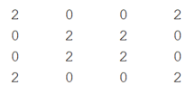
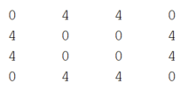

Ref) Adjacency Matrix / 인접 행렬
Interesting properties of Adjacency Matrix : Matrix powers
  Let A be the Adjacency Matrix representing the graph below
  In this case, the result of A^2 is shown on the left, and the result of A^3 is shown on the right. What is the meaning of each result??
2
$$A=\left[\begin{matrix}\begin{matrix}0 & 1 \\ 1 & 0\end{matrix} & \begin{matrix}1 & 0 \\ 0 & 1\end{matrix} \\ \begin{matrix}1 & 0 \\ 0 & 1\end{matrix} & \begin{matrix}0 & 1 \\ 1 & 0\end{matrix}\end{matrix}\right]$$
1
4
3

Slide 29
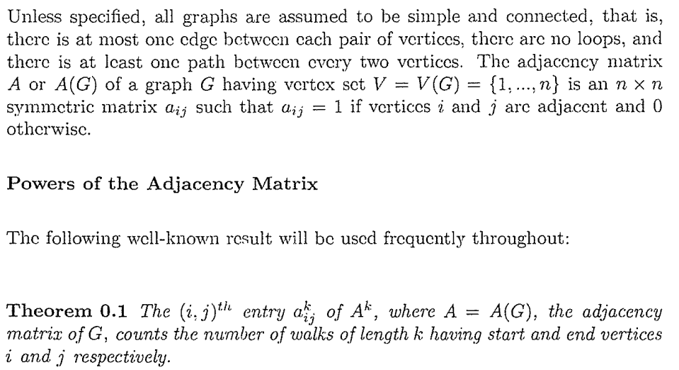
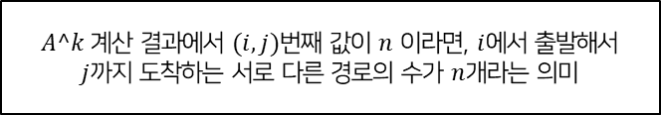
Ref) Adjacency Matrix / 인접 행렬
Interesting properties of Adjacency Matrix : Matrix powers
$A^k$ 계산 결과에서 $(i,j)$번째 값이 $n$ 이라면, $i$에서 출발해서 $j$까지 도착하는 서로 다른 경로의 수가 $n$개라는 의미

Slide 30

끝.
오늘 강의는 여기까지!

